Slide 1

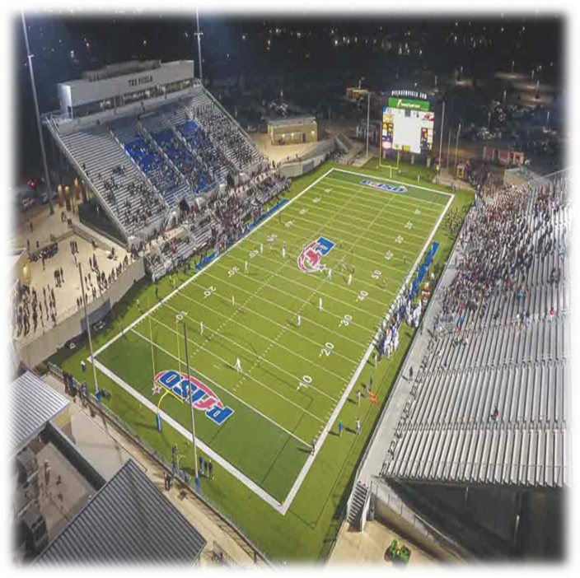


Texas Syndicate Football
Building Central Texas’ community-owned summer football platform
Pflugerville, Texas • Home venue secured at The Pfield • 2026 CoFL launch
10,000-seat stadium • 2.55M Austin metro • 1.7M+ digital views/impressions in 90 days

Slide 2
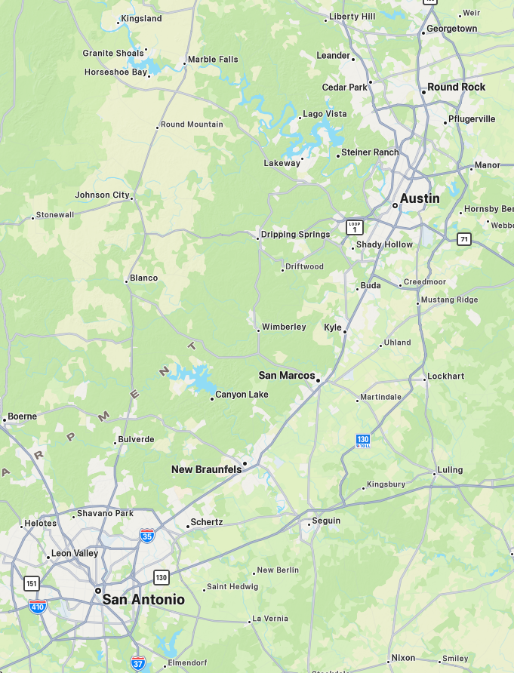
Why this window exists now
Central Texas is still growing. Families keep moving north and east of Austin. Football demand is strong.
The market has college and high-school passion, but limited north-corridor professional football inventory.
A summer football property can monetize games, sponsorship, digital content, camps, and community programming.
Notes:
“We are entering a football-hungry region with demographic growth, suburban family density, and an existing venue rather than trying to manufacture demand from scratch.”

Slide 3
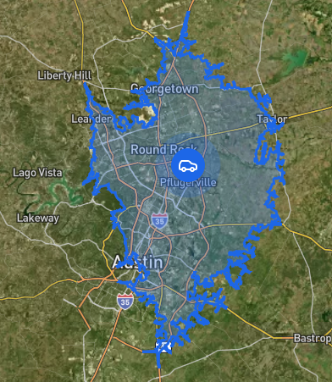
The market we serve
Primary catchment: Pflugerville, Round Rock, Hutto,
Georgetown, Cedar Park
Extended corridor: Austin, San Marcos, New Braunfels,
San Antonio
Young suburban family based with recurring summer
entertainment demand
Notes:
“The most important point here is that this is not a one-city story. It is a corridor story with rivalry and drive-in upside.”

Slide 4
The product and league fit
Texas Syndicate competes in the 2026 Continental Football League preview season.
All CoFL games stream live on the league’s United Football Media YouTube channel.
The CoFL’s fourth-quarter ‘Continental Shift’ gives the product a distinct broadcast identity.
team → division → divisional championship → Continental Cup
Notes:
“We are realistic about league-stage risk, but the product is live, streamed, differentiated, and already generating regional coverage.”

Slide 5
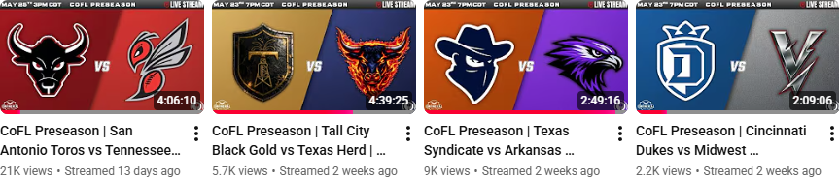
Proof of traction
1.7M+ total views and impressions in 90 days
137K+ accounts reached
83%+ new audience discovery
Secured 10,000-seat home venue at The Pfield
Notes:
“Before asking investors to believe in scale, we show them evidence of discoverability and venue readiness.”

Slide 6


Revenue model
Primary revenue streams: sponsorship, ticketing/game day, merchandise, digital ads, camps and tryouts
Base-case public model: $327K operating revenue in 2026
Revenue mix is sponsorship-led, with game day and digital providing diversification

Slide 7
Sponsorship engine
Current official categories already map to high-value local industries: bank, automotive, healthcare, beverage, restaurant, hotel, fitness, insurance
Public sponsor pricing is live and expandable into higher anchor tiers
Rivalry-weekend, broadcast, and community-impact inventory create sellable premium assets
Package level | Recommended price band | Best use | KPI focus
Community Partner | $1,000–$5,000 | Local SMBs | scans, redemptions, logo reach
Official Category Partner | $7,500–$15,000 | Exclusivity by industry | leads, hospitality, mentions
Founding Partner | $15,000–$25,000 | Premium team/field/broadcast inventory | impressions, activations, client hosting
Presenting / Rivalry / Broadcast Title | $25,000–$50,000+ | Anchor regional brands | multi-channel reach, partner-qualified leads, PR v
Notes:
“Sponsorship is not speculative. The architecture already exists. What we need is better packaging, stronger sales discipline, and anchor-partner pricing.”

Slide 8
Current model and three-year projection
2026 public base case: $327K revenue
Illustrative build: 2027 $475K revenue; 2028 $650K revenue
Growth drivers: sponsor upsell, improved attendance, camps, digital inventory, rivalry packaging
Notes:
“Only the 2026 base case is public team guidance; the 2027–2028 figures are illustrative management-style scenarios built conservatively on the current model.”

Slide 9
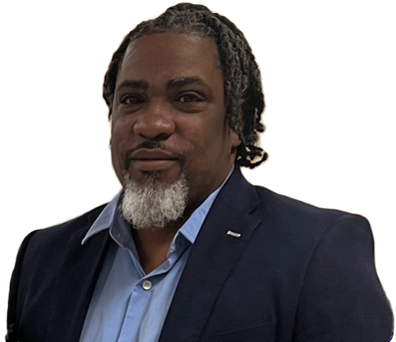
Team, governance, and community moat
Founder-led, veteran-led, mission-led
Mental-health advocacy, youth development, and community programming differentiate the brand
Front office and public-sector partnership model are already visible in team materials
GM
Ned Herrington
Head Coach
James Champagne
Athletic Trainer
James Trigg
Dir S&M
Heidi Wilson
Community
Notes:
“This slide is where you turn ‘nice mission language’ into a moat that helps both sponsorship and retention.”

Slide 10
Use of funds
Recommended raise: $400K–$500K bridge / strategic round
Use of funds: commercial sales, roster and football ops, production and content, working capital, community programs, contingency
Target outcome: stronger sponsor pipeline, better game-day operations, cleaner path to 2027 scale
Notes:
“Investors want to know exactly what gets built with their money, and what milestones unlock the next stage.”

Slide 11
Risks and how we manage them
League-stage risk
Schedule volatility
Early-stage operating execution
Mitigation: venue secured, local sponsor model, diversified revenue, dated schedule snapshots, contingency planning
Risk | Mitigation
League-stage risk | Team-controlled revenue and local sponsor model
Schedule volatility | Dated schedule snapshots + sponsor make-goods
Early-stage execution | Funded operations + weekly KPI tracking
Revenue concentration | Diversified sponsor and revenue streams
Cash-flow timing | Working capital + contingency reserve
Notes:
“A serious deck names the risk, quantifies what can be controlled locally, and avoids pretending the environment is frictionless.”

Slide 12
Why Partner With Texas Syndicate Football?
Digital Audience
1.7 MILLION+
Views & Impressions in 90 Days
137,000+
Accounts Reached
83%
New Audience Discovery
Sponsors receive:
Build local brand awareness
Connect with loyal sports fans
Increase community credibility
Gain social media exposure
Host clients and employees at games
Roster Momentum:
Texas Syndicate continues to build a competitive roster, including the signing of the 5th-ranked wide receiver from the AF1 indoor football league.
Audience continues to grow weekly across Instagram, X, LinkedIn, and Facebook.
High-impact player signings help drive highlights, fan interest, broadcast engagement, and sponsor visibility.

Slide 13
The ask and the next milestones
Seeking strategic capital and anchor partners to scale the 2026–2027 build
Immediate milestones: sponsor closes, attendance execution, community activations, media/production consistency, investor conversion
The 2026 season is the proof year. The goal is to convert early momentum into sponsor renewals, recurring fan revenue, community ownership, and a stronger 2027 growth platform.
Contact:
Quincy Workman
Founder & Owner,
Texas Syndicate Group LLC
info@texassyndicategroup.com
@coflsyndicate

